Slide 1
Digital Transformation using Microsoft 365
Vignesh Ganesan
@Anbu_Mani27

Slide 2

Section Title
Section Sub Title

Slide 3
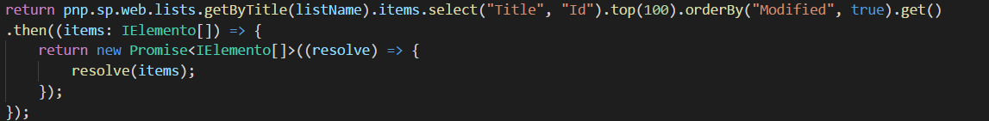
Title
Content
Content

Slide 4

Enjoy the Bootcamp

Slide 5

Call to action
Share your feedback on Bootcamp at https://aka.ms/Microsoft365DevBootcampSurvey2019
Join Office 365 developer program https://dev.office.com/devprogram to leverage all resources for Office 365 development learning
Build applications on Office 365 platform
Attend MVP led local community events to continue learning on Office 365 development

